Slide 1
Lecture 10
- Classifications of parallel computers
- Interconnection Network

Slide 2
Introduction
Parallel computing refers to the process of executing several processors an application or computation simultaneously.
It is done by multiple CPUs communicating via shared memory, which combines results upon completion.
In distributed computing we have multiple autonomous computers which seems to the user as single system.
In distributed systems there is no shared memory and computers communicate with each other through message passing.
In distributed computing a single task is divided among different computers.

Slide 3
A. Classifications of parallel computers
ILP and TLP provide parallelism at a very low level; they’re typically controlled by the processor and the compiler, and their use isn’t directly controlled by the programmer.
For our purposes, hardware is parallel if the parallelism is visible to the programmer.
We use two main classifications of parallel hardware: Flynn’s Taxonomy and shared vs. distributed memory.
Flynn’s taxonomy distinguishes between the number of instruction streams and the number of data streams a system can simultaneously manage.

Slide 4
Cont.,
In a shared-memory system each core has access to the same “shared” block of main memory.
In a distributed-memory system each core has a private block of memory, to which only it has direct access.
If a core needs to access a memory location in another core’s block, it will communicate over the network.

Slide 5
1. Flynn’s Classification
He looked at the parallelism in the instruction and data streams, and placed all computers into one of four categories:
Single instruction stream, single data stream (SISD)
Single instruction stream, multiple data streams (SIMD)
Multiple instruction streams, single data stream (MISD)
Multiple instruction streams, multiple data streams (MIMD)

Slide 6
SIMD
Single instruction: All processing units execute the same instruction issued by the control unit at any given clock cycle as shown in the following figure.
Multiple data: Each processing unit can operate on a different data element as shown if figure.
The processor are connected to shared memory or interconnection network providing multiple data to processing unit.
This type of machine typically has an instruction dispatcher (single control unit), a very high- bandwidth internal network, and a very large array of very small-capacity instruction units.

Slide 7
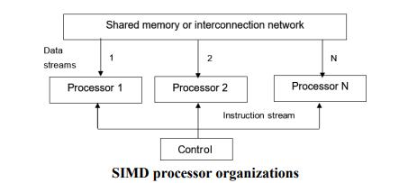
Best suited for specialized problems characterized by a high degree of regularity, such as image processing and vector computation.

Slide 8
MISD
Here, a single data stream is feed into multiple processing units.
Each processing unit operates on the data independently through independent instruction streams as shown in following figure.
A single data stream is forwarded to different processing unit which are connected to different control unit and execute instruction given to it by control unit to which it is attached.
Thus, in these computers same data flow through a linear array of processors executing different instruction streams.

Slide 9
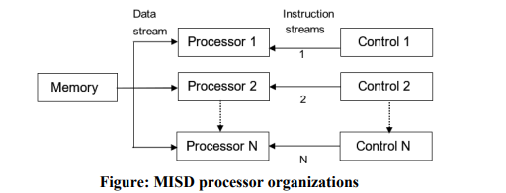
This architecture is also known as systolic arrays for pipelined execution of specific instructions.
Systolic array computers are used in various applications, particularly in fields where high-performance parallel computations (HPC) is essential.

Slide 10
MIMD
Multiple Instructions: every Processor may be executing a different instruction stream.
Multiple Data: every processor may be working with a different data stream as shown in the figure multiple data stream is provided by shared memory.
Can be categorized as loosely coupled or tightly coupled depending on sharing of data and control.
Execution can be synchronous or asynchronous, deterministic or non- deterministic.

Slide 11
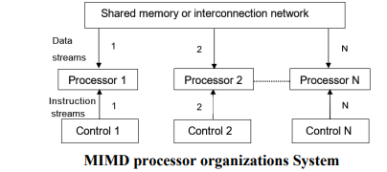

Slide 12
2. Shared Memory & Distributed Memory
In a shared-memory system a collection of autonomous processors is connected to a memory system via an interconnection network, and each processor can access each memory location.
In a distributed-memory system, each processor is paired with its own private memory, and the processor-memory pairs communicate over an interconnection network.

Slide 13
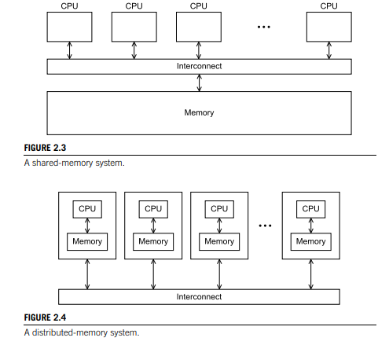

Slide 14
Shared memory Systems
The most widely available shared-memory systems use one or more multicore processors.
A multicore processor has multiple CPUs or cores on a single chip.
In shared-memory systems with multiple multicore processors, the interconnect can either connect all the processors directly to main memory (Uniform memory access, or UMA).
Or, each processor can have a direct connection to a block of main memory, and the processors can access each other’s blocks of main memory through special hardware built into the processors (Nonuniform memory access or NUMA).

Slide 15
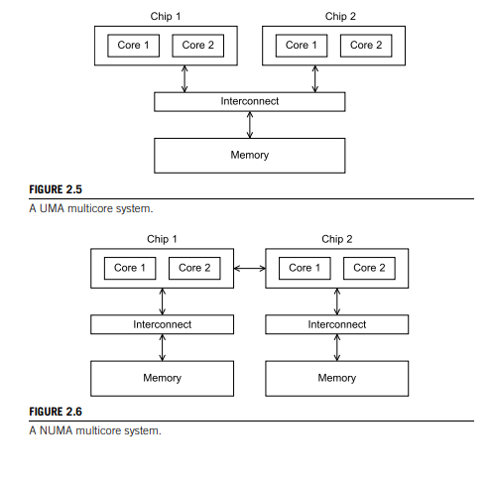

Slide 16
Note:
UMA systems are usually easier to program, since the programmer doesn’t need to worry about different access times for different memory locations.
This advantage can be offset by the faster access to the directly connected memory in NUMA systems.
Furthermore, NUMA systems have the potential to use larger amounts of memory than UMA systems.

Slide 17
Distributed Memory Systems
To overcome the limitations of shared-memory systems, high-performance computing moved to distributed-memory systems.
This shift also meant that many programs had to make use of message passing instead of modifying shared data as a means of communication and synchronization between threads.
Unfortunately, message-passing models have proven to be much more difficult and error-prone compared to the shared-memory programming models.
The most widely available distributed-memory systems are called clusters & Grid computing systems.

Slide 18
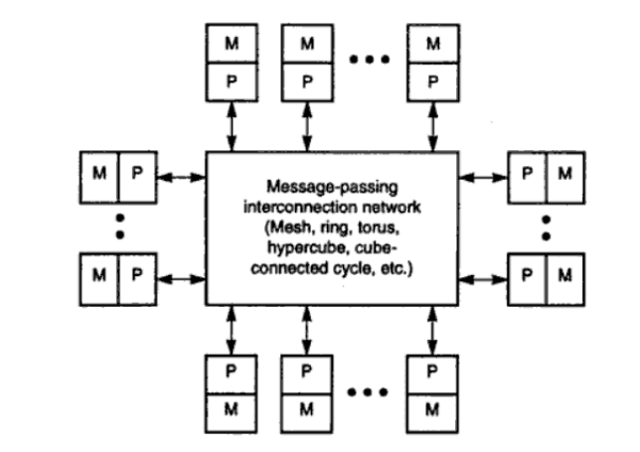

Slide 19
1- Cluster computing
The most widely available distributed-memory systems are called clusters.
They are composed of a collection of commodity systems—for example, PCs—connected by a commodity interconnection network—for example, Ethernet.
In fact, the nodes of these systems, the individual computational units joined together by the communication network, are usually shared-memory systems with one or more multicore processors.

Slide 20
Cont.,
A characteristic feature of traditional cluster computing is its homogeneity.
In most cases, the computers in a cluster are largely the same, have the same operating system, and are all connected through the same network.
Cluster computing is used for parallel programming in which a single program is run in parallel on multiple machines.

Slide 21
Cluster Structure
Each cluster consists of a collection of compute nodes that are controlled and accessed by means of a single master node (Head node) .
The master typically handles the allocation of nodes to a particular parallel program (Scheduler).
As such, the master actually runs the middleware needed for the execution of programs and management of the cluster,
The compute nodes are equipped with a standard operating system extended with typical middleware functions for communication, storage, fault tolerance, and so on.

Slide 22
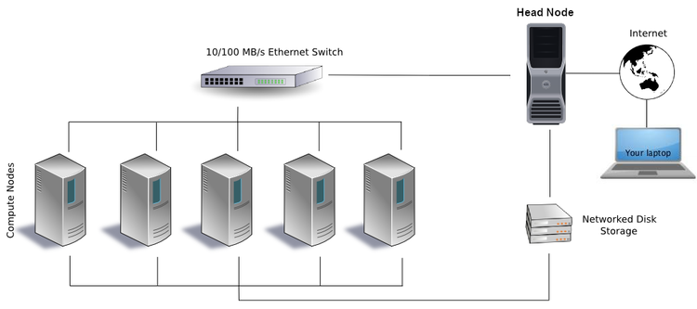
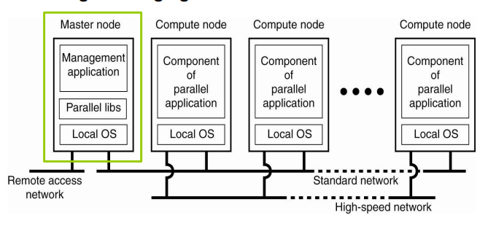

Slide 23
2- Grid computing
The grid provides the infrastructure necessary to turn large networks of geographically distributed computers into a unified distributed-memory system.
In general, such a system is heterogeneous, that is, the individual nodes are built from different types of hardware.
This diversity is even more prevalent in grid-computing systems: no assumptions are made concerning similarity of hardware, operating systems, networks, administrative domains, security policies, etc.

Slide 24
Grid Computing Network
A typical grid computing network consists of three machine types:
Control node/server: A control node is a server or a group of servers that administers the entire network and maintains the record for resources in a network pool.
Provider/grid node: A provider or grid node is a computer that contributes its resources to the network resource pool.
User: A user refers to the computer that uses the resources on the network to complete the task.

Slide 25
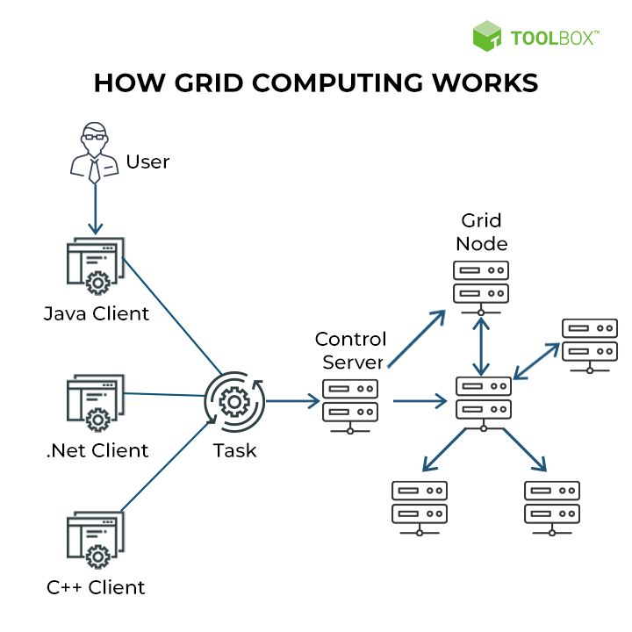

Slide 26
B. Interconnection Networks
The interconnect plays a decisive role in the performance of both distributed- and shared-memory systems.
Even if the processors and memory have virtually unlimited performance, a slow interconnect will seriously degrade the overall performance of all but the simplest parallel program.
Although some of the interconnects have a great deal in common, there are enough differences to make it worthwhile to treat interconnects for shared-memory and distributed-memory separately.
Various types of interconnection networks have been suggested for SIMD & MIMD computers.

Slide 27
Network Topologies
These are basically have been classified on network topologies into two categories namely :
Static Networks : point-to-point direct connection which will not change during program execution.
Dynamic Networks : are implemented with switched channels which are dynamically configured to match the communication demands in user programs.

Slide 28
Network Properties & Routing
The goals of an interconnection network are to provide low-latency high data transfer rate wide communication bandwidth.
Analysis includes latency, bisection bandwidth, data-routing functions and scalability of parallel architecture.
Data Routing Functions: A data routing network is used for inter-PE (Processing Element) data exchange.
It can be static as in case of hypercube routing network or dynamic such as multistage network.

Slide 29
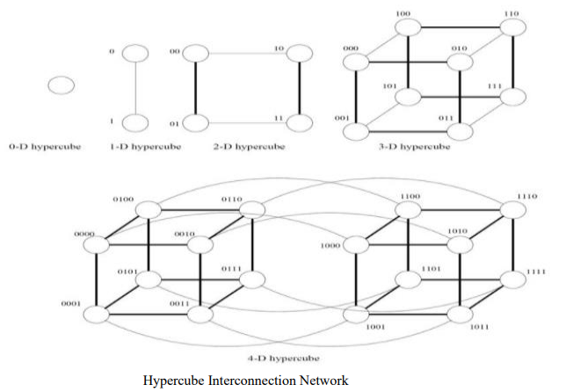
Static Interconnection Networks
Static interconnection networks can have many structures such as a linear structure (pipeline), a matrix, a ring, a torus, a complete connection structure, a tree, a star, a hypercube.

Slide 30
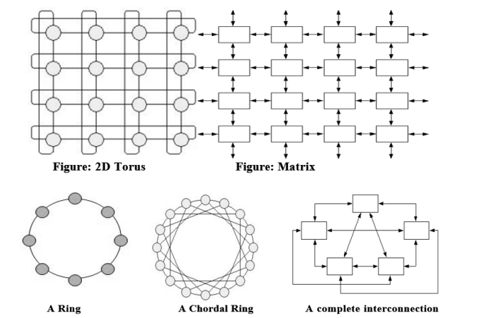
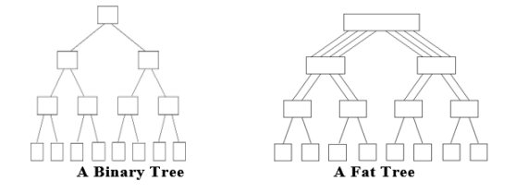

Slide 31
Dynamic Interconnection Networks
Dynamic interconnection networks between processors enable changing (reconfiguring) of the connection structure in a system.
It can be done before or during parallel program execution.
So, we can speak about static or dynamic connection reconfiguration.
Usually all processing elements are equidistant and an interconnection path is established when two processing elements want to communicate by use of switches.

Slide 32
Cont.,
Such systems are more difficult to expand as compared to static network.
Examples: Bus-based, Crossbar, Multistage networks.

Slide 33
Example 1: Crossbar network
Crossbar network is a single stage network shown in the following figure.
A single stage switching network with N input selectors (IS) and N output selectors (OS).
In order to establish a desired connecting path, different path control signals will be applied to all IS and OS selectors.
Only one crosspoint switch can be set on in each row or column.

Slide 34
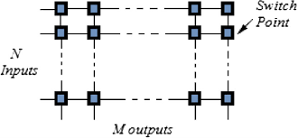
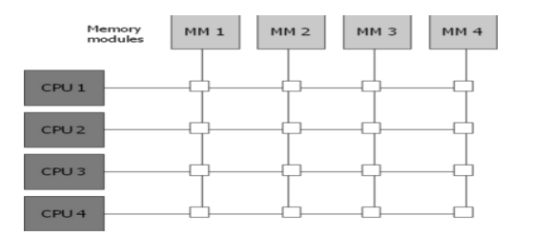

Slide 35
Example 2: Omega Network
Omega network is a multistage network.
A multistage network is capable of connecting any input terminal to any output terminal.
Multi-stage networks are basically constructed by so called shuffle-exchange switching element, which is basically a 2 x 2 crossbar switches.
Shuffle exchange maps X to Y, where Y is obtained from X by shifting one bit to the left and wrapping around the MSB to LSB.
Example: 001 -> 010

Slide 36
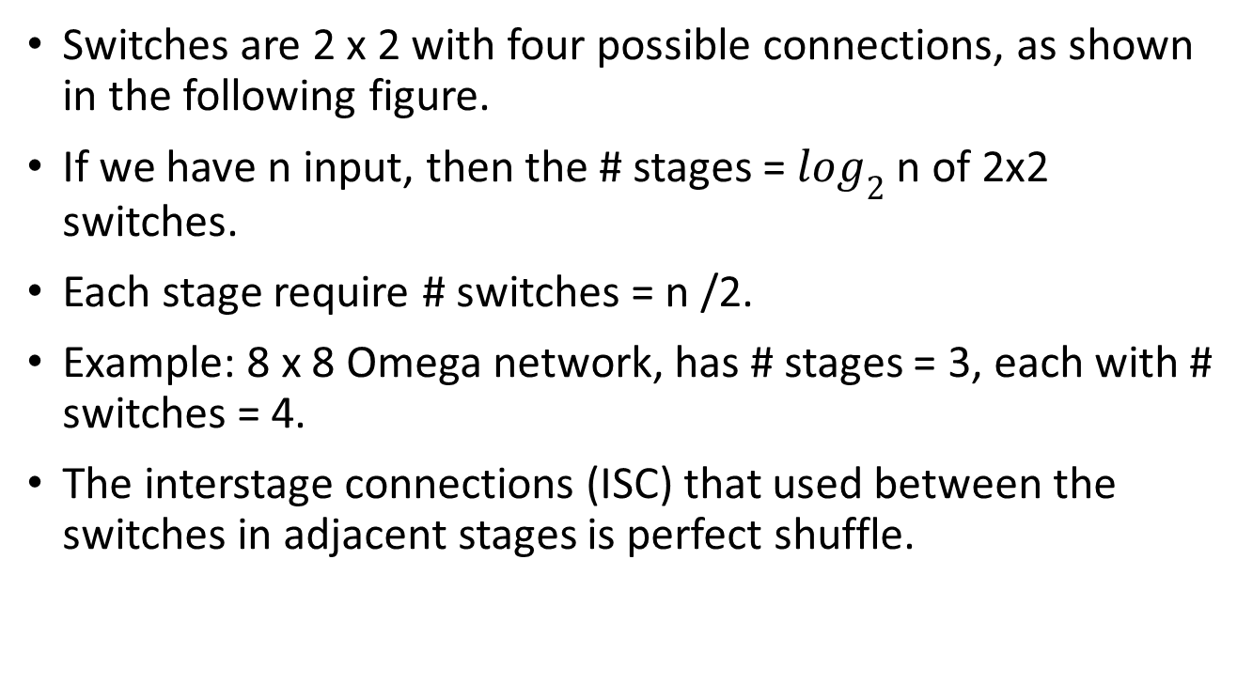
Cont.,
Switches are 2 x 2 with four possible connections, as shown in the following figure.
If we have n input, then the # stages = $\log_{2}$ n of 2x2 switches.
Each stage require # switches = n /2.
Example: 8 x 8 Omega network, has # stages = 3, each with # switches = 4.
The interstage connections (ISC) that used between the switches in adjacent stages is perfect shuffle.

Slide 37
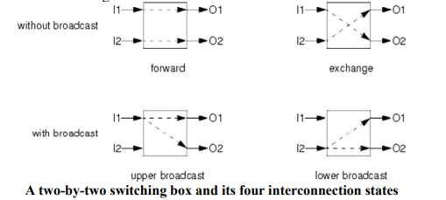
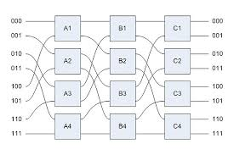

Slide 38

Data Routing in Omega Network
When the $i^{th}$ high-order bit of the destination code is ‘0’, a 2 x2 switch stage i connects the input to the upper output.
Otherwise, the input is directed to the lower output.

Slide 39
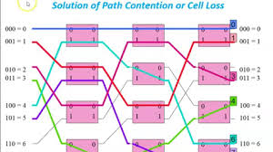
Example
Example: perform the following permutation:
(0,0), (1,1), (2,3), (3, 4), (4, 6), (5, 7)

Slide 40
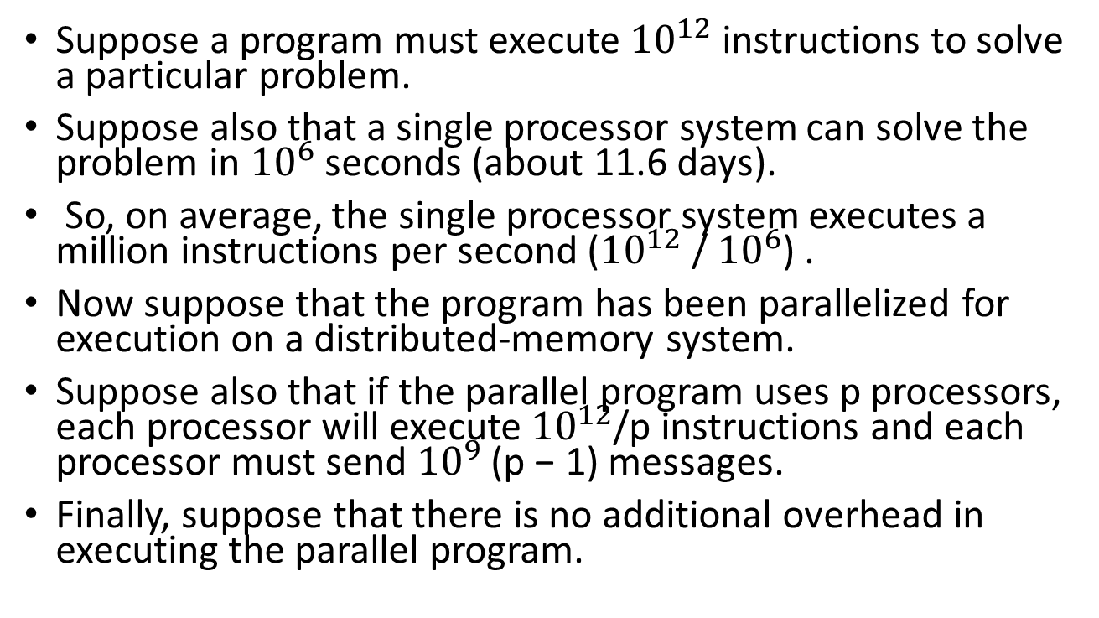
Assignment
Suppose a program must execute ${10}^{12}$ instructions to solve a particular problem.
Suppose also that a single processor system can solve the problem in ${10}^{6}$ seconds (about 11.6 days).
So, on average, the single processor system executes a million instructions per second (${10}^{12}$ / ${10}^{6}$) .
Now suppose that the program has been parallelized for execution on a distributed-memory system.
Suppose also that if the parallel program uses p processors, each processor will execute ${10}^{12}$/p instructions and each processor must send ${10}^{9}$ (p − 1) messages.
Finally, suppose that there is no additional overhead in executing the parallel program.

Slide 41
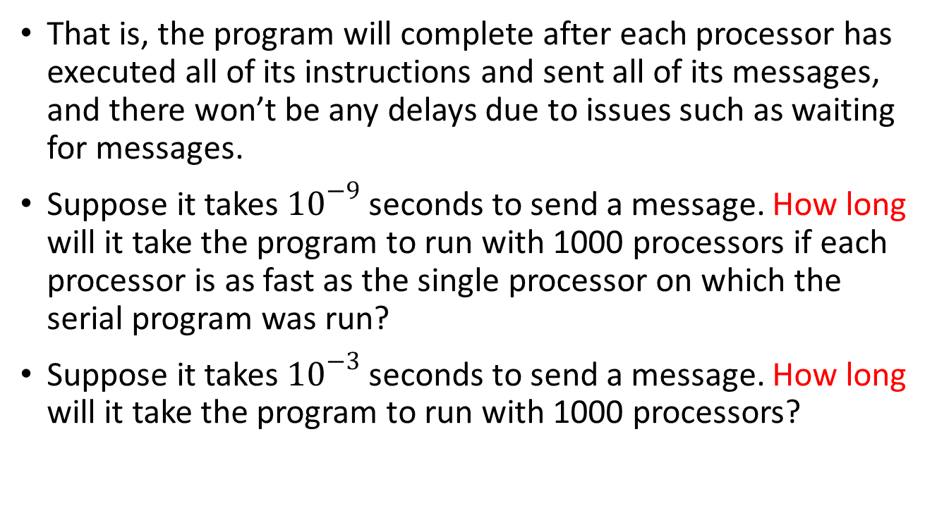
Cont.,
That is, the program will complete after each processor has executed all of its instructions and sent all of its messages, and there won’t be any delays due to issues such as waiting for messages.
Suppose it takes ${10}^{−9}$ seconds to send a message. How long will it take the program to run with 1000 processors if each processor is as fast as the single processor on which the serial program was run?
Suppose it takes ${10}^{−3}$ seconds to send a message. How long will it take the program to run with 1000 processors?

